Slide 1

Data Visualization with Seaborn
Presented by:
Inuwa Mobarak
22/08/23

Slide 2
Introduction to Seaborn
Seaborn is a Python data visualization library based on Matplotlib.
It provides a high-level interface for creating visually appealing statistical graphics.
Coonects well with Pandas.
Handles datasets easily allowing you focus more on result and not the process.

Slide 3
Why Seaborn?
Simplifies complex visualizations with fewer code.
Offers beautiful and informative default styles.
Works well with Pandas DataFrames.
Built-in functions for common statistical plot types.
Hanldes complex statistics well.

Slide 4
Importing Seaborn
Importing Seaborn
import seaborn as sns
Importing Matplotlib
import matplotlib.pyplot as plt

Slide 5
Seaborn Components/Functions
They provide interactions with seaborn through a set of plotting functions.
They provide interactions with seaborn through a set of plotting functions.

Slide 6
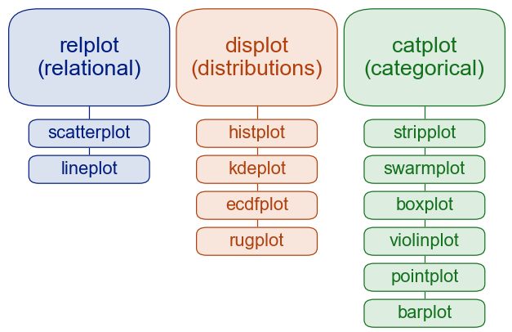
Seaborn Module Organization
Seaborn modules are structured around modules including “relational”, “distributional”, and “categorical”.

Slide 7
Relational Plots API interface
Relplot: It is designed to visualize many different statistical relationships. Worry less about the specification.
# Load an example dataset
tips = sns.load_dataset("tips")
# Create a visualization
sns.relplot(
data=tips,
x="total_bill", y="tip", col="time",
hue="smoker", style="smoker", size="size",
)

Slide 8
Relational Plots API interface
Scatterplot: Draw a scatter plot with possibility of several semantic groupings.
diamonds = sns.load_dataset("diamonds")
sns.scatterplot(x="carat", y="price",
hue="clarity", size="depth", linewidth=0,
data=diamonds)

Slide 9
Relational Plots API interface
Lineplot: Draws a line plot.
sns.set_theme(style="darkgrid")
# Loading fmri dataset
fmri = sns.load_dataset("fmri")
# Ploting the responses for different subject and signal
sns.lineplot(x="subject", y="signal",
hue="event", style="event",
data=fmri)

Slide 10
Distribution Plots API interface
Distplot: drawing distribution plots on FacetGrid.
import seaborn as sns
sns.set_theme(style="darkgrid")
df = sns.load_dataset("penguins")
sns.displot(
df, x="bill_depth_mm", col="island")

Slide 11
Distribution Plots API interface
Histplot: Plot univariate or bivariate histograms to show distributions of datasets. Histplot: Defaul value and uses the same underlying code as distplot().
sns.set_theme(style="ticks")
diamonds = sns.load_dataset("diamonds")
sns.histplot(
diamonds,
x="price", hue="cut")

Slide 12
Distribution Plots API interface
Univariate data:
penguins = sns.load_dataset("penguins")
sns.displot(penguins, x="flipper_length_mm", hue="species", col="sex")

Slide 13
Distribution Plots API interface
Kernel Identity Estimation(kde):
sns.displot(penguins, x="flipper_length_mm", kind="kde")
To accurately represent the data depends on the choice of smoothing bandwidth:
sns.displot(penguins, x="flipper_length_mm", kind="kde", bw_adjust=.25) # play with bw_adjust
Other parameters to add:
hue="species"
multiple="stack"

Slide 14
Distribution Plots
Plotting Distributions:
sns.pairplot(penguins)

Slide 15
Categorical Plots API
Categorical scatterplots:
stripplot() (with kind="strip"; the default)
swarmplot() (with kind="swarm")
Categorical distribution plots:
boxplot() (with kind="box")
violinplot() (with kind="violin")
boxenplot() (with kind="boxen")
Categorical estimate plots:
pointplot() (with kind="point")
barplot() (with kind="bar")
countplot() (with kind="count")

Slide 16
Categorical Plots API
Categorical scatterplots:
tips = sns.load_dataset("tips")
sns.catplot(data=tips, x="day", y="total_bill")
There is default parameter called jitter that sets randomness to avoid overlapping of points.
sns.catplot(data=tips, x="day", y="total_bill", jitter=False)
We can also use swarm to properly display our scatter.
kind="swarm"
We could also use hue="sex" for styling and more info.

Slide 17
Categorical Plots API
Categorical distribution plots: shows the three quartile values of the distribution.
sns.catplot(data=tips, x="day", y="total_bill", kind="box")
Hue parameter distinguishes:
hue="smoker"
Violinplots: Combines a boxplot with the kernel density estimation procedure.
sns.catplot(data=tips, x="total_bill", y="day", hue="sex", kind="violin")

Slide 18
Categorical Plots API
Categorical Estimate Plots: Shows an estimate of the central tendency of the values using two main ways to show this information.
pointplot() (with kind="point")
barplot() (with kind="bar")
countplot() (with kind="count")
To conntinue:
https://seaborn.pydata.org/tutorial/categorical.html

Slide 19
Thank you!

